Slide 1
Linking Background Risk to Subsidy Levels in Higher Education
Kyle Davis

Slide 2
A Model for Higher Education
A Very Great Degree of Differentiation among institutions
Availability of non-tuition resources
Non-tuition resources are used to subsidize students
Student demand is sensitive to the subsidy levels they receive
School’s that face strong demand, and limit supply, create a better queue of applicants
Student quality is a primary determinant of educational quality
Student demand is sensitive to educational quality, hence to student quality
(Winston & Yen 1995)

Slide 3
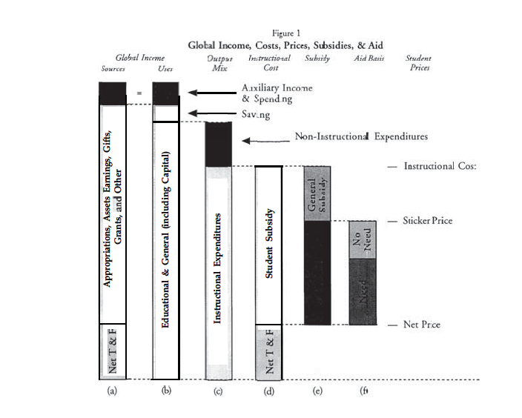
Higher Ed. Financial Structure
(Winston & Yen 1995)

Slide 4
Strategic Decisions
A Decision on Size
A Decision on Cost Per Student
A Decision on Output Mix
A Decision on Sticker Price
A decision on Merit-Based and Need-Based Aid
(Winston & Yen 1995)

Slide 5
Thesis Research
Background Risk is a concept derived from risk aversion¹
An increased sense of risk from one decision will influence our risk aversion for a different decision
Has been applied to asset allocation of higher education endowments¹
This project seeks to explore the effects of background risk on higher education subsidy levels
¹(Dimmock 2012)

Slide 6
Data
Data from National Center for Education Statistics
Spans from 2004-2015
Used three survey’s
Finance
Fall Enrollment
Institutional Characteristics
Created same variables used in Costs, Prices, Subsidies, and Aid in U.S. Higher Education by Gordon C. Winston and Ivan C. Yen

Slide 7
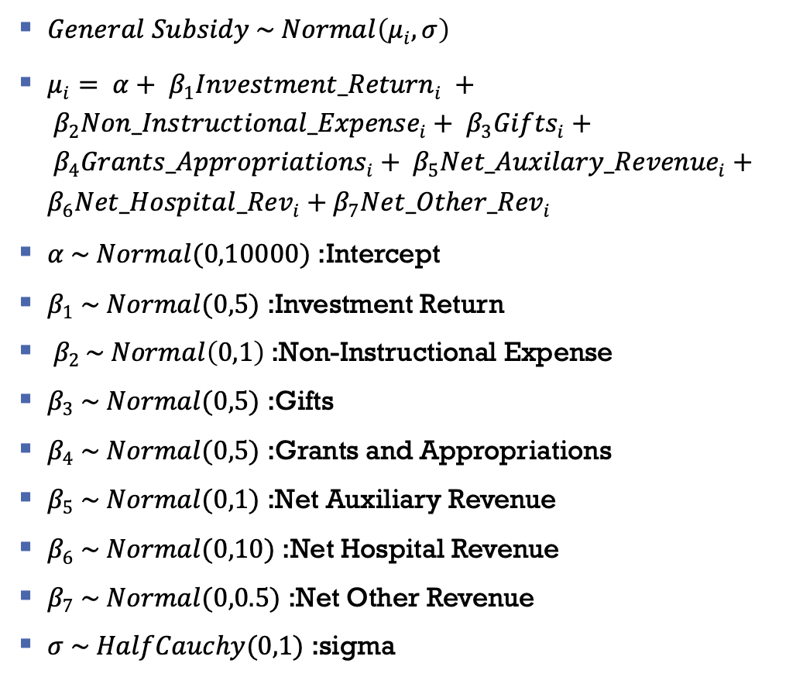
Priors
$General Subsidy \sim Normal\left(μ_{i}, σ\right)$
$μ_{i}= α+ β_{1}{Investment_Return}_{i} + β_{2}{Non_Instructional_Expense}_{i}+ β_{3}{Gifts}_{i}+ β_{4}{Grants_Appropriations}_{i}+ β_{5}{Net_Auxilary_Revenue}_{i}+β_{6}{Net_Hospital_Rev}_{i}+β_{7}{Net_Other_Rev}_{i}$
$α \sim Normal(0,10000)$ :Intercept
$β_{1} \sim Normal(0,5)$ :Investment Return
$β_{2 }\sim Normal\left(0,1\right)$:Non-Instructional Expense
$β_{3} \sim Normal(0,5)$ :Gifts
$β_{4} \sim Normal(0,5)$ :Grants and Appropriations
$β_{5} \sim Normal(0,1)$ :Net Auxiliary Revenue
$β_{6} \sim Normal(0,10)$ :Net Hospital Revenue
$β_{7} \sim Normal(0,0.5)$ :Net Other Revenue
$σ \sim HalfCauchy(0,1)$ :sigma

Slide 8
Model Diagnostics
HMC/NUTS Chains
Energy Information
Autocorrelation

Slide 9
Model Diagnostics
Posterior Predictive Distribution
Test Statistics Distribution

Slide 10
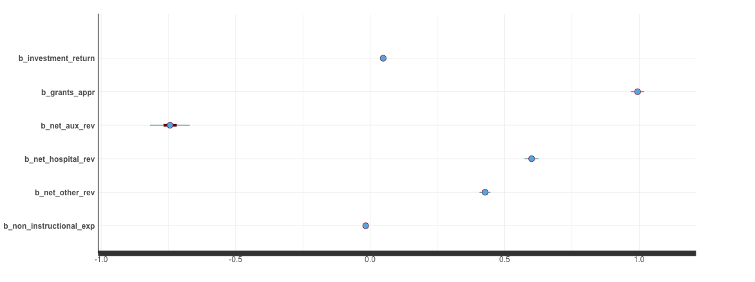
Model Results
Summary Output:
Coefficient Parameters

Slide 11
Concluding Remarks
Limitations
NCES changed their data structure between prior literature and this project
This has resulted in slightly different calculations in the outcome variable general subsidy
Data used does not capture entire higher education universe
Further Work:
Transition models from BRMS -> Stan programming language
Expand data set to capture more schools and a larger time period
Explore non-linear models

Slide 12
Works Cited
Dimmok, Stephen G. Background Risk and University Endowment Funds. Aug. 2012, papers.ssrn.com/sol3/Delivery.cfm/SSRN_ID1548586_code425372.pdf?abstractid=921910.
Goodrich, Benjamin. Bayesian Statistics in the Social Sciences. Columbia University in the City of New York, New York. Spring 2019.
Winston, Gordon C., and David J. Zimmerman. “Peer Effects in Higher Education: A Look at Heterogeneous Impacts.” Economics of Education Review, Pergamon, 30 Jan. 2014, www.sciencedirect.com/science/article/pii/S0272775714000168.
Winston, Gordon, C. 1999. "Subsidies, Hierarchy and Peers: The Awkward Economics of Higher Education." Journal of Economic Perspectives, 13 (1): 13-36.
Winston, Gordon C., and Ivan C. Yen. Costs, Prices, Subsidies, and Aid in U.S. Higher Education. 1995, sites.williams.edu/wpehe/files/2011/06/DP-32.pdf.

